Slide 1


Knowledge Hub
June 10, 2021

Slide 2

INCREASING PRESSURES TO RAISE MORE MONEY
PhilanthropyLab
Engage, Inform, Empower

Slide 3
FUNDING matters® Inc.
PUTTING THE DONOR FIRST
Engage, Inform, Empower

Slide 4
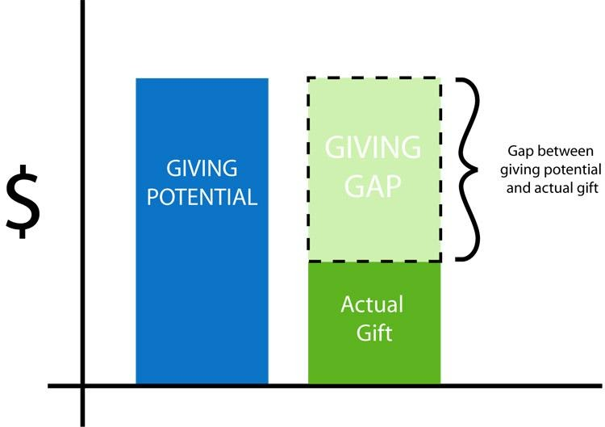
HOW TO INCREASE THE SIZE OF YOUR DONATIONS
Giving Gap™
PUTTING THE DONOR FIRST
Engage, Inform, Empower

Slide 5

BRIDGING THE
GIVING GAP™
PUTTING THE DONOR FIRST
Engage, Inform, Empower

Slide 6

7 STEP
PDX Model for Donor Engagement and Activation
PUTTING THE DONOR FIRST
Engage, Inform, Empower

Slide 7

7 STEP
Step One
BRAINSTORM
PUTTING THE DONOR FIRST
Engage, Inform, Empower

Slide 8

7 STEP
PUTTING THE DONOR FIRST
Engage, Inform, Empower

Slide 9

7 STEP
PUTTING THE DONOR FIRST
Engage, Inform, Empower

Slide 10

7 STEP
PUTTING THE DONOR FIRST
Engage, Inform, Empower

Slide 11

7 STEP
PUTTING THE DONOR FIRST
Engage, Inform, Empower

Slide 12
WHY STOCKS ARE BETTER THAN CASH DONATIONS
7 STEP
PUTTING THE DONOR FIRST
Engage, Inform, Empower

Slide 13

7 STEP
PUTTING THE DONOR FIRST
Engage, Inform, Empower

Slide 14

7 STEP
PUTTING THE DONOR FIRST
Engage, Inform, Empower

Slide 15
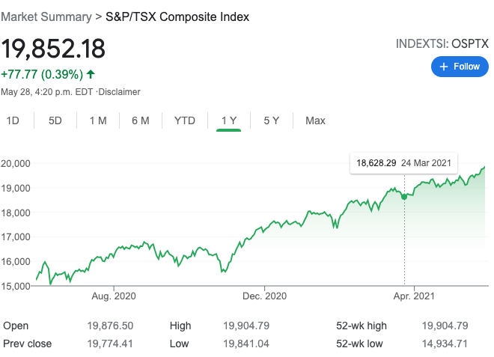
Gifts of Assets are pro-social. Cash gifts aren’t.
7 STEP
PUTTING THE DONOR FIRST
Engage, Inform, Empower

Slide 16

7 STEP
PUTTING THE DONOR FIRST
Engage, Inform, Empower

Slide 17
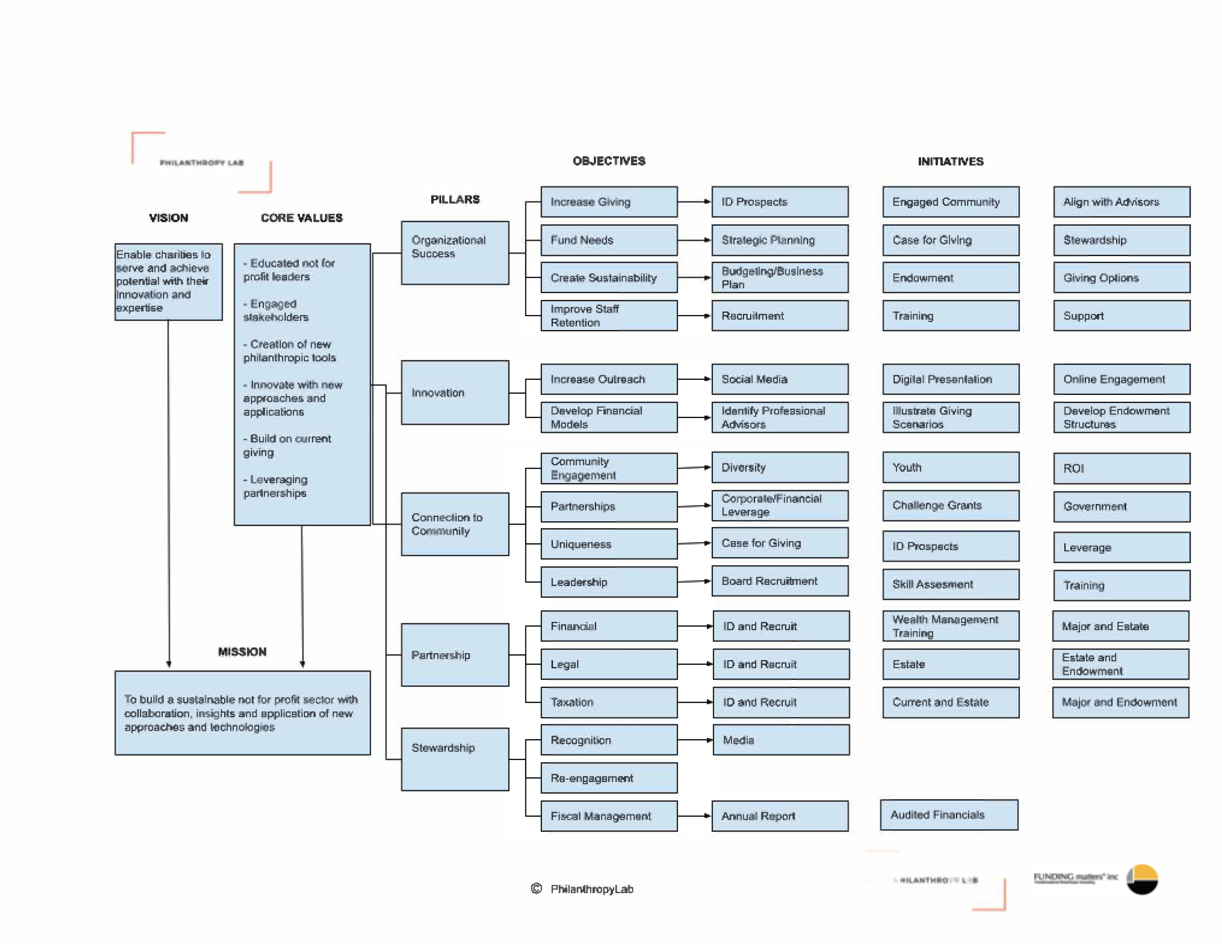
PUTTING THE DONOR FIRST
Engage, Inform, Empower

Slide 18
Thank you!
Send an email to Info@fundingmatters.com to sign up for our weekly blog OR to request a GIFTABULATOR demo.
Let’s stay connected.
PhilanthropyLab
Engage, Inform, Empower

